Slide 1
Embedding Analytics Into Job Embeddedness Theory
Seminar 7, Team 6
Chan Shi Hui Amanda U1910759K
Lee Yi Shan U1810232H
Harvinder Singh Chahal U1910668J
Lum Yao Zong, Edward U1810185G
Fung Kai Xiang Daniel U1921788J
Notes:
Good morning prof and friends, we are from team 6 and my group consists of Yi Shan, Harvinder, Edward, Daniel, and myself, Amanda. Our main objective for this presentation is to embed analytics into job embeddedness theory.

Slide 2

CONTENT OUTLINE
01
02
03
04
THE PROBLEM
OUR PROCESS
OUR MODELS
OUR SOLUTION
Tackling turnover with the Job Embeddedness Framework
Data cleaning & preparation
Modelling each component of the Framework
Recommendations & Limitations
Chan Shi Hui Amanda
Notes:
This will the the content outline for today’s presentation.

Slide 3
01
THE PROBLEM
Chan Shi Hui Amanda
Notes:
Firstly, the problem.

Slide 4
UNDERSTANDING THE PROBLEM
High employee turnover
Unable to identify employees with high flight risk
Chan Shi Hui Amanda
Notes:
Let us all first understand White Rock’s problem. Employee turnover rates at investment and asset management companies have risen rapidly over the years. This holds true even during the current covid-19 pandemic where employee turnover rates have not declined. This may be due to better job opportunities.
In order to stay competitive in the asset management industry, White Rock cannot afford to lose its best employees. Currently, based on assumption, White Rock faces an issue of employee retention as it is unable to easily identify employees that have higher flight risk. Therefore, White Rock requires a solution which is able to identify current, as well as predict future high flight risk individuals based on employee factors.

Slide 5
SIGNIFICANCE OF PROBLEM
White Rock is in the asset management industry, great personalized clientele experience is essential
Replacing an employee incurs high turnover costs
High employee turnover negatively influences other employees’ morale
Chan Shi Hui Amanda
Notes:
High employee turnover poses a significant problem as great personalized clientele experience is essential in the asset management industry provided by the employees. Moreover, replacing an employee incurs high turnover costs of up to millions, and having a high employee turnover will negatively influence other employees’ morale causing other employees to leave too hence further increasing the turnover rate.
assuming 1000 employees, turnover rate of 16.7% (from a source salary.com), average monthly salary of $50k a year, estimated turnover costs would be 1.5x
= 1.5 * 167 * 50k
= 12.5 mil

Slide 6
Job Embeddedness Theory
Fit
Link
Sacrifice
Common values between White Rock and employee
YearsAtCompany
Linear Regression model
Integratedness between White Rock and employee
JobInvolvement
CART model
What the employee stands to lose if he resigns
JobSatisfaction
CART model
Chan Shi Hui Amanda
Notes:
Therefore, we will be using the Job Embeddedness Theory which consists of the fit, link and sacrifice framework to help solve White Rock’s issue.
Fit is the congruence of common values between White Rock and the employee, measured using YearsAtCompany. We chose YearsAtCompany as the y-variable as employees tend to stay longer when they match company culture, indicating a commonality of values and beliefs between them and White Rock. We use the linear regression model as YearsAtCompany is a continuous variable.
Next, Link is the integratedness between White Rock and employee, measured by JobInvolvement. Higher JobInvolvement levels signify greater responsibilities and opportunities to build relationships in the workplace. Thus, it is a proxy for how linked an employee is. We use the Classifcation and Regression Trees model also known as CART model since JobInvolvement is a categorical variable.
Lastly, Sacrifice is what the employee stands to lose if he resigns, measured by JobSatisfaction. JobSatisfaction represents an overall value that employees derive from their job. This includes contentment with their colleagues, sense of achievement and remuneration. We use the CART model again as JobSatisfaction is a categorical variable.

Slide 7

EMPLOYEE ATTRITION
Combine all 3 variables to predict employee’s attrition
Determine if an employee is likely to stay on or resign
Using logistic regression
Chan Shi Hui Amanda
Notes:
Attrition is the employment status of the employee with the company. We will combine all 3 variables, YearsAtCompany, JobInvolvement and JobSatisfaction from fit, link and sacrifice respectively to determine an employee’s attrition if he/she is likely to stay on or resign. We will then be using the logistic regression model to measure employee’s attrition since it is a binary categorical variable.

Slide 8
BENEFITS OF JOB EMBEDDEDNESS THEORY
Target specific variables which are negatively affecting an employee’s job embeddedness
Obtain a predictive summary of employees’ job embeddedness
Reduce opportunity cost in terms of time spent manually conducting interviews
Reduce high turnover costs
Chan Shi Hui Amanda
Notes:
The benefits of job embeddedness theory is firstly, it allows White Rock to target specific variables which are negatively affecting an employee’s job embeddedness hence less wastage of resources is incurred from targeting at the insignificant variables. This also helps to improve job embeddedness directly and efficiently.
Next, we can obtain a predictive summary of the employees’ job embeddedness such as their JobSatisfaction which is more objective as some employees may feel deterred to voice out their dissatisfaction to White Rock during their annual performance review.
Additionally, with our suggested use of questionnaire which will be further explained in detailed by Daniel later under our business recommendations, White Rock do not need to manually conduct interviews to find out what their employees truly feel about their job, collecting more truthful employee sentiments. This reduces opportunity cost in terms of time spent manually conducting interviews when the time could have better be spent on coming up with solutions to retain the employees.
All these will in turn help White Rock save on turnover costs by improving employee’s job embeddedness and hence, reduce employee attrition.

Slide 9
02
OUR PROCESS
Lee Yi Shan
Notes:
To embed analytics into job embeddedness theory, the first analytical step is to prepare the data for analysis.
The preparatory work includes data cleaning, running correlation matrix to determine the data tables and doing train-test split for each of the data tables.

Slide 10
DATA CLEANING PROCESS
Duplicated Values
Wrong values
02
04
01
03
Test Values
Unnecessary columns
Dropped “?????” in Application.ID which is an identifier
Dropped duplicated rows
Dropped rows related to testing
Dropped identification info & other unused columns
Lee Yi Shan
Notes:
We start the data cleaning process by checking for rows that are entirely duplicates of each other. We chose to drop all duplicated rows instead of keeping one unique row of each duplicated set as we are unsure of how the error arises so it is better to be prudent.
After checking for duplicate values, we note that there are values like “test”, “test 456”. We reasoned that these values are likely to be inserted into the dataset during system testing. Tests values are dropped since they are not genuine records of employees.
Aside from test values, we also found strange values like ????. What is more important is that these values are found in Application.ID column. As we know, during the usual hiring process, an applicant would have to submit their application before they are considered for employment in the company. Therefore, the subsequent records of the employee are dependent on the existence of Application.ID. All in all, Application.ID is important and we apply a more stringent rule to clean it which is to drop the row relating to invalid values.
This stringency is in comparison with the non-identifier columns that are simply dropped in step 4. For example, we noted that multiple values of “Marketing” are present within the EmployeeCount column which is irregular since that column mostly contain the value of 1. However, we do not drop these rows because unlike Application.ID, EmployeeCount is not a unique identifier and its irregularity does not render the entire row invalid.

Slide 11
DATA CLEANING PROCESS
Illogical Values
VERIFICATION
06
08
05
07
NA & MISSING VALUES
Export cleaned dataset
Drop any additional invalid rows
Export to CSV & split data for each component
Lee Yi Shan
Notes:
After dropping unnecessary columns, we checked for illogical values in the remaining columns. Details are in slide 12 → GO SLIDE 12
After dealing with illogical values, we proceeded to clean NA and missing values. Details are in slide 13 → GO SLIDE 13
Last but not least, we did a final verification on the dataset and reperformed the check for illogical values and dropped any additional invalid rows.
With this, we ended our data cleaning process and this dataset is exported to CSV.

Slide 12
DATA CLEANING - Illogical values
Illogical conditions | Treatment
YearsAtCompany > TotalWorkingYears | Dropped 6 rows
YearsInCurrentRole > TotalWorkingYears | 0 rows found
YearsInCurrentRole > YearsAtCompany | 0 rows found
YearsWithCurrManager > YearsAtCompany | 0 rows found
TotalWorkingYears > Age - 18 | Dropped 248 rows
HourlyRate > DailyRate | 0 rows found
DailyRate >MonthlyRate | 0 rows found
Lee Yi Shan
Notes:
We listed out some illogical conditions. These illogical conditions can classified into two groups which are years and rate. So the first few rows relate to years. Something to point out is that for the third last row, we check for TotalWorkingYears > Age - 18. The expression [Age - 18] represents the maximum number of years an employee could possibly work. And why 18, so that is an assumption made by our group that the earliest age an employee could start work is 18, and also because in the dataset there is a column named Over18.
These illogical values are common-sense outliers which are also dropped.

Slide 13
DATA CLEANING - NA & Missing values
NA & missing values arise from
(b) General steps in cleaning each column
Missing values in dataset
Forced coercion when setting appropriate data types (subsequently dropped since it is an indication of invalid values)
Check for the type of error - systematic or error
For categorical variable - missing value is replaced with mode & check for unreasonable level
For continuous variable - missing value is replaced with mean
Lee Yi Shan
Notes:
Firstly, we differentiated between NA & missing values that arise from missing values in dataset vs forced coercion. Forced coercion happens when we tried to set appropriate data types but the value is of a different data type e.g. it is supposed to be an integer but a character is found there. For NA & missing values from forced coercion, they are dropped since it would mean it is an invalid value.
Next, for the remaining NA and missing values, we clean each column individually. We inspected the rows with NA values to determine if the error is systematic or at random. If it is a systematic error, we would replace the value with the subgroup’s mode or mean whereas for random error, we would replace the value with population’s mode or mean.
Generally, for categorical variables. The missing value is replaced with mode and unreasonable or inconsistent cateogry are removed.
For continuous variable, the missing value is replaced with mean.

Slide 14
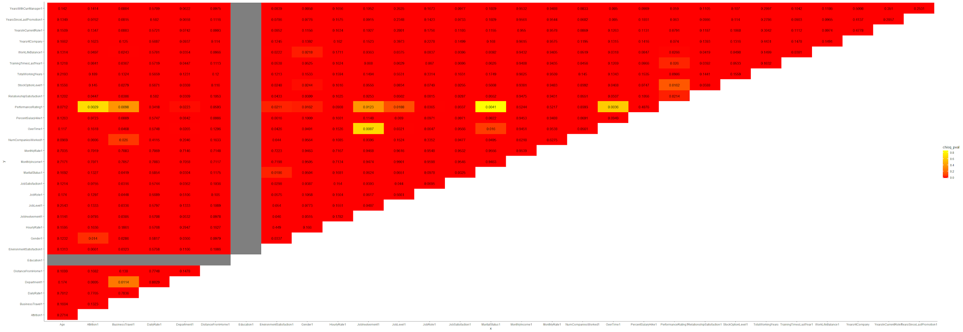
DATA CORRELATION
Fit (Y variable: YearsAtCompany)
DailyRate, JobLevel, JobRole, MonthlyIncome, MonthlyRate, TotalWorkingYears, YearsInCurrentRole, YearsSinceLastPromotion, YearsWithCurrManager
Link (Y variable: JobInvolvement)
Age, HourlyRate, DailyRate, MonthlyIncome, MonthlyRate, PercentSalaryHike, TotalWorkingYears, YearsInCurrRole, YearsWithCurrManager
Sacrifice (Y variable: JobSatisfaction)
Age, DailyRate, HourlyRate, MonthlyIncome, MonthlyRate, TotalWorkingYears, YearsInCurrentRole
Lee Yi Shan
Notes:
With the cleaned dataset, we generated a correlation matrix. The purpose of the correlation matrix is to checked for potential x variables that are more closely related to the y variable of each component. Shown on the slide is the insights obtained from the correlation matrix.

Slide 15
TRAIN-TEST SPLIT
For each data table:
0.7 split ratio
30% test data to examine the accuracy of our models
Set.seed to ensure the same train & test data each time the code runs
Lee Yi Shan
Notes:
Based on the insights from correlation matrix, three data tables for each component of the job embeddedness theory are drawn up.
For each data table, we did a train-test split with a split ratio of 0.7 and set.seed to ensure the same train & test data each time the code runs.

Slide 16
03
OUR MODELS
Harvinder Singh Chahal

Slide 17
Fit
Harvinder Singh Chahal

Slide 18
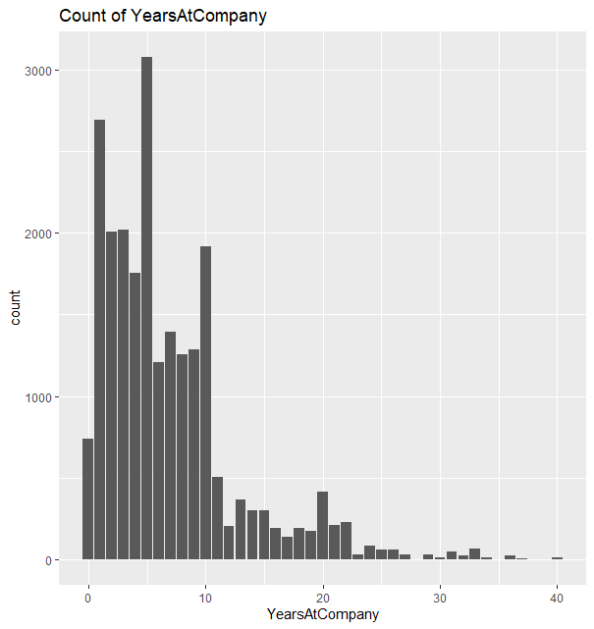
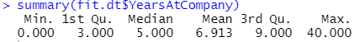
DATA EXPLORATION (FIT)
Analysis of YearsAtCompany
Majority of employees have only spent 10 years or less at the company
Median/Mode: 5 yrs
Mean: 6.91 yrs
A suitable y-variable as we are seeking to improve attrition rate, which indirectly requires years at company to improve
Harvinder Singh Chahal

Slide 19
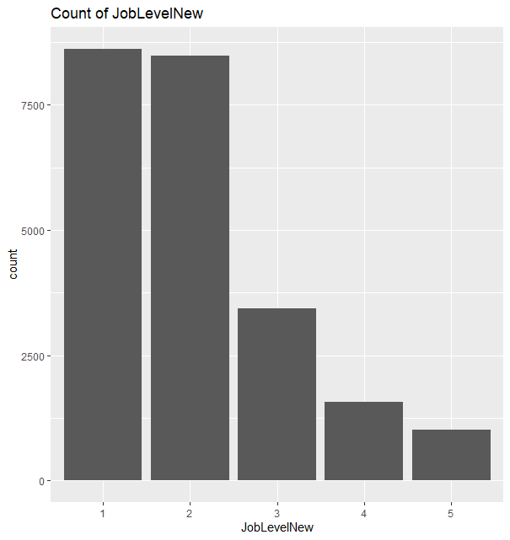
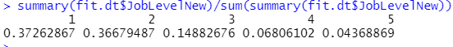
DATA EXPLORATION (FIT)
Analysis of JobLevelNew
As job level increases, the number of employees holding these jobs decreases
Two thirds of employees hold jobs with level 2 or lower
Level1:37.26%
Level2:36.67%
Harvinder Singh Chahal

Slide 20
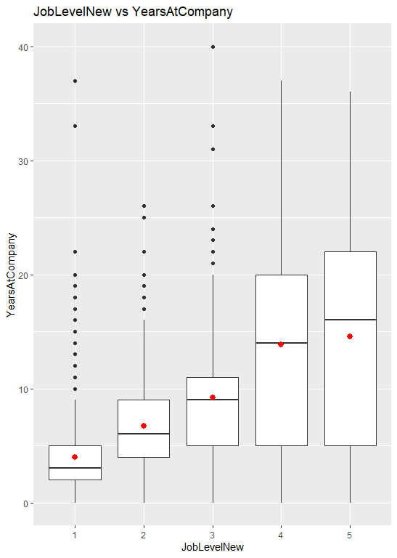
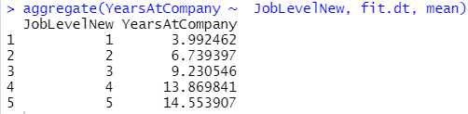
DATA EXPLORATION (FIT)
Analysis of JobLevelNew
In contrast, when job level increases then number of years spent at the company increases.
Level1: 3.99 yrs
Level5: 14.55 yrs
Hence we can conclude a majority of employees spend less than 10 yrs at the company, supporting the results viewed in YearsAtCompany
Harvinder Singh Chahal

Slide 21
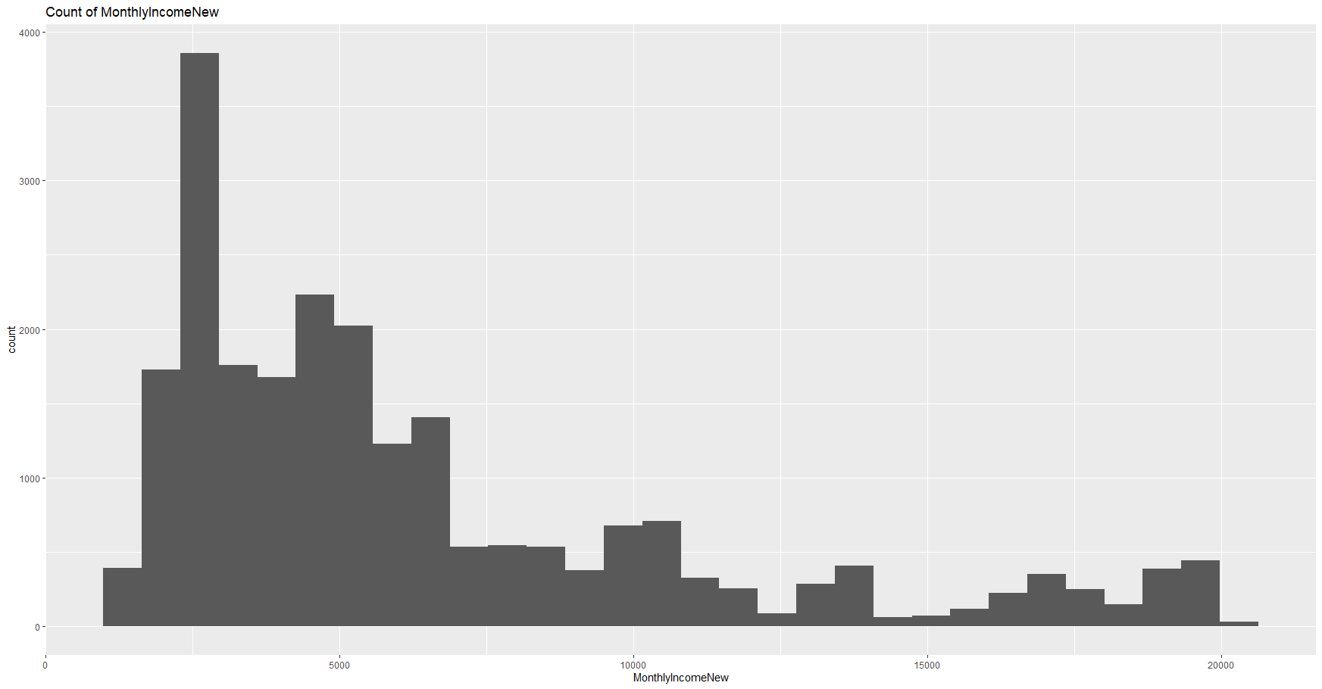
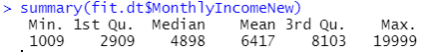
DATA EXPLORATION (FIT)
Analysis of MonthlyIncomelNew
The majority of employees make $7500 or less
Mean:$6417
Median:$4898
Harvinder Singh Chahal

Slide 22
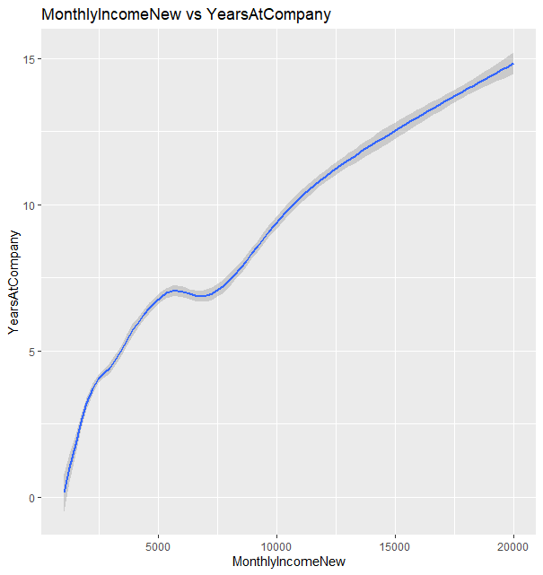
DATA EXPLORATION (FIT)
Analysis of MonthlyIncomelNew
In contrast, as monthly income increases, years at company also increases
At $7500yrs, YearsAtCompany is less than 10, supporting the results viewed in YearsAtCompany
Harvinder Singh Chahal

Slide 23
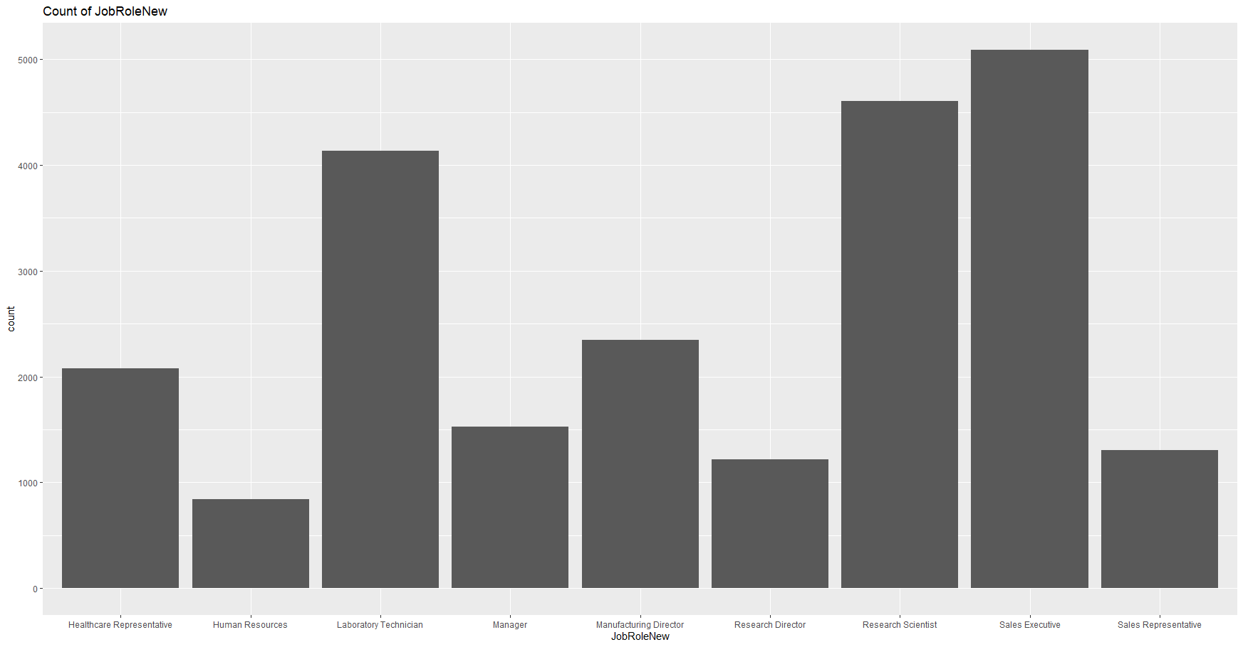
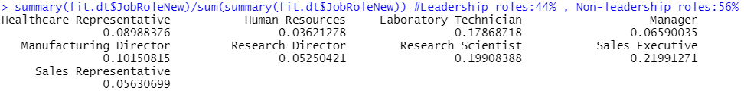
DATA EXPLORATION (FIT)
Analysis of JobRolesNew
No. of non leadership roles :56%
No. of leadership roles (Executives, Directors, Managers): 44%
Harvinder Singh Chahal

Slide 24
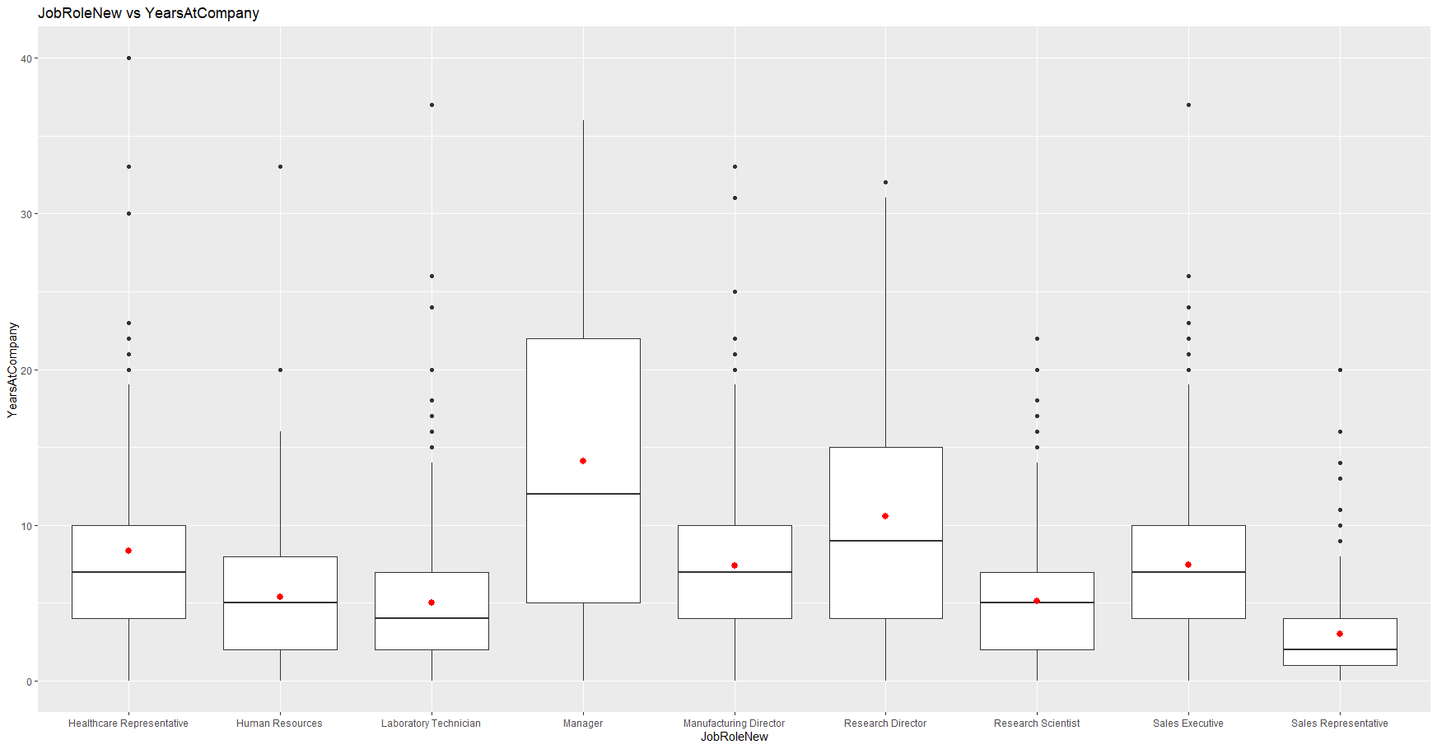
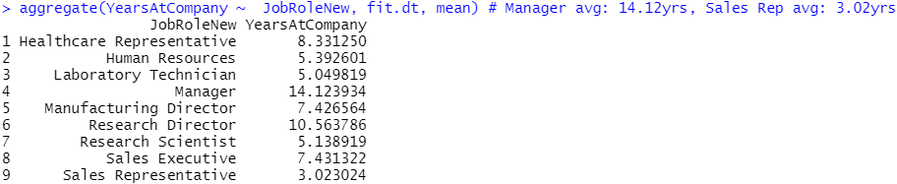
DATA EXPLORATION (FIT)
Analysis of JobRolesNew
Employees with leadership roles stay longer at the company
Manager average:14.12 yrs
Sales Rep. average:3.02 yrs
Hence we can conclude a majority of employees spend less than 10 yrs at the company, supporting the results viewed in YearsAtCompany
Harvinder Singh Chahal

Slide 25
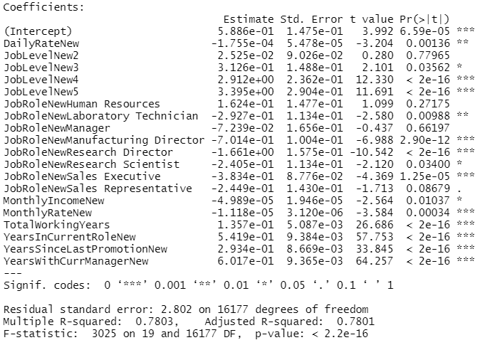
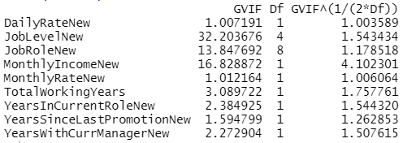
DATA MODELLING (FIT) - Linear Regression
Fit.lm1
Step 1: Apply linear model on YearsAtCompany with data from fit train set
Step 2: Get summary.
All variables statistically significant with and adjusted R-squared value of 0.78. However, some coefficients are negative
Step 3: Conduct multicollinearity test
Remove variable with highest VIF value
Harvinder Singh Chahal

Slide 26
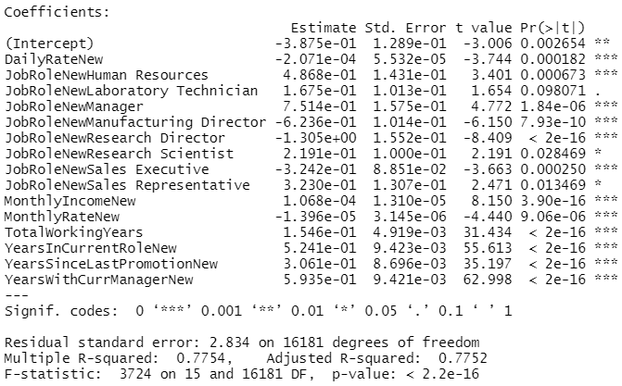
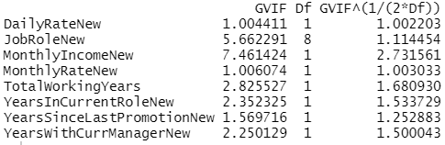
DATA MODELLING (FIT) - Linear Regression
Fit.lm2
Step 1: Apply linear model
Step 2: Get summary.
All variables statistically significant with adjusted R-squared of 0.77
Step 3: Ensure all VIF values < 10
Harvinder Singh Chahal

Slide 27
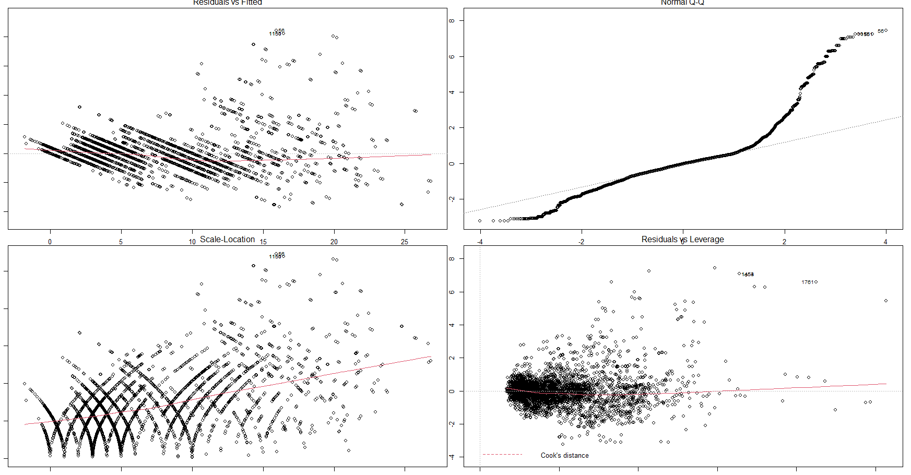
DATA MODELLING (FIT) - Linear Regression
Fit.lm2
Step 4: Conduct diagnostic check.
All graphs are acceptable, except Normal Q-Q which does not follow a normal distribution with mean 0.
Harvinder Singh Chahal

Slide 28
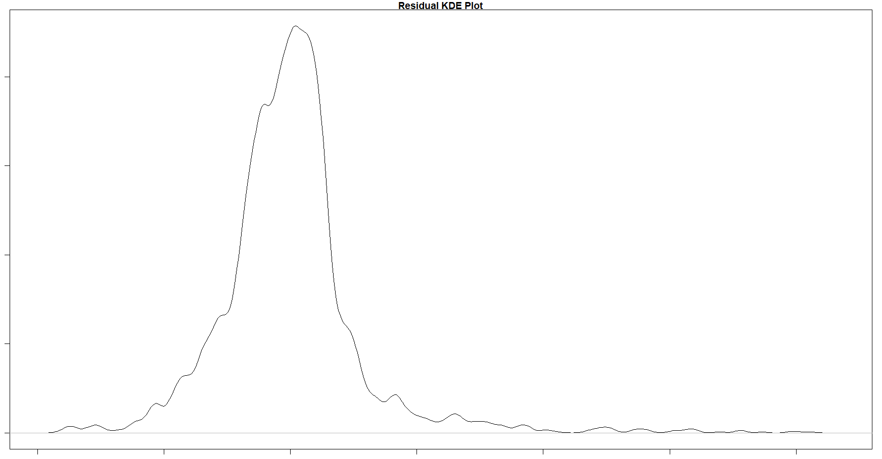
DATA MODELLING (FIT) - Linear Regression
Fit.lm2
Step 5: Conduct residual check.
Right skewed graph
Harvinder Singh Chahal

Slide 29
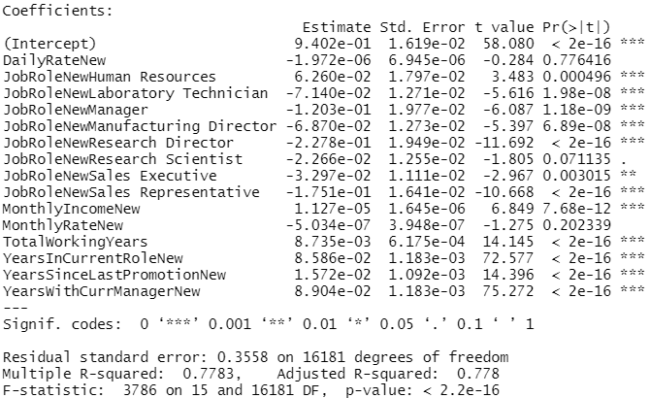
DATA MODELLING (FIT) - Linear Regression
Fit.lm3
Step 1: Apply linear model on log(YearsAtCompany+1)
Step 2:Get summary.
Adjusted R-squared value of 0.77
Remove statistically insignificant variables
Harvinder Singh Chahal

Slide 30
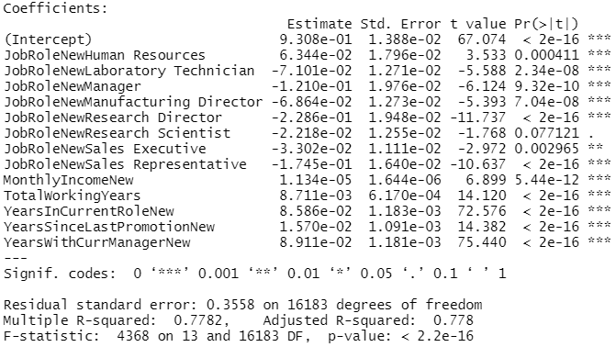
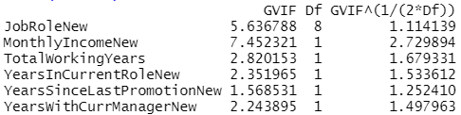
DATA MODELLING (FIT) - Linear Regression
Fit.lm4
Step 1: Apply linear model
Step 2: Get summary.
All variables statistically significant with adjusted R-squared of 0.77
Step 3: Ensure all VIF values < 10
Harvinder Singh Chahal

Slide 31
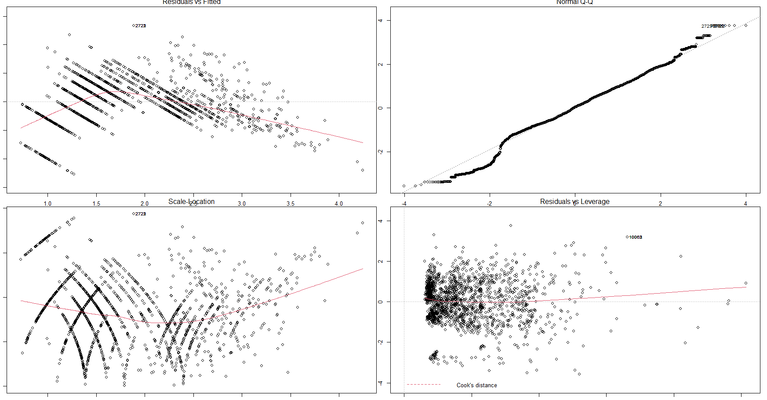
DATA MODELLING (FIT) - Linear Regression
Fit.lm4
Step 4: Conduct diagnostic check.
All graphs are acceptable
Harvinder Singh Chahal

Slide 32
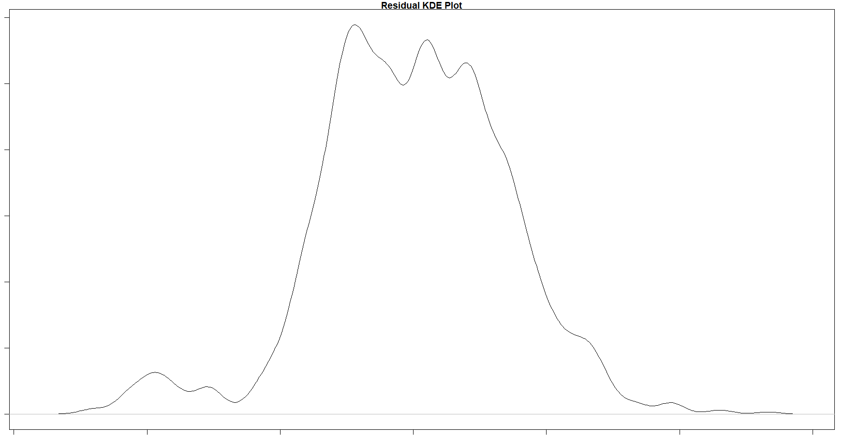
DATA MODELLING (FIT) - Linear Regression
Fit.lm4
Step 5: Conduct residual check
Harvinder Singh Chahal

Slide 33
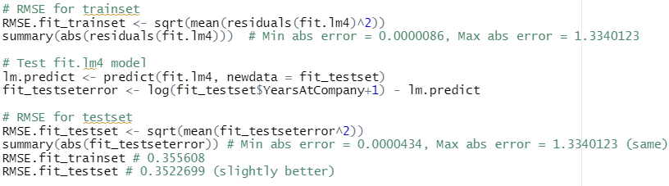
DATA MODELLING (FIT) - Linear Regression
RMSE
Finally we check the RMSE of fit.lm4 when predicting the YearsAtCompany using the trainset and testset.
Trainset RMSE:0.355
Testset RMSE:0.352
This suggests the the model is effective in predicting accurate results for Fit
Harvinder Singh Chahal

Slide 34
Link
Harvinder Singh Chahal

Slide 35
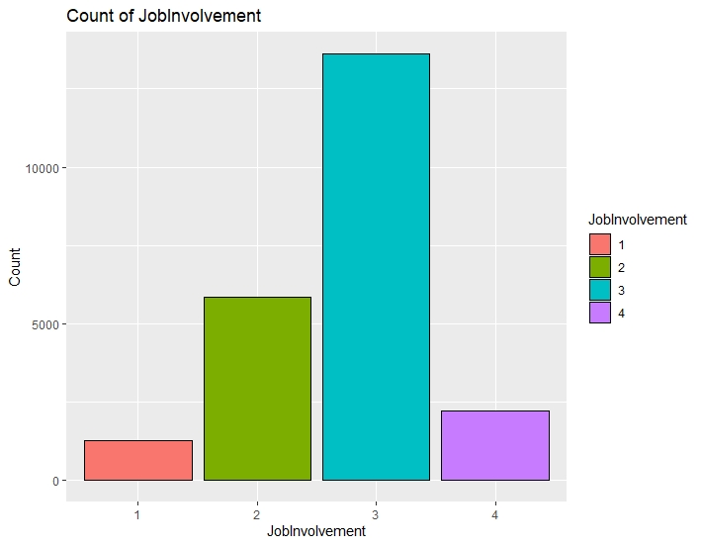
DATA EXPLORATION (LINK)
Analysis of JobInvolvement
Majority of employees have high job involvement levels
Generally participative in their job scopes psychologically and emotionally
Harvinder Singh Chahal

Slide 36
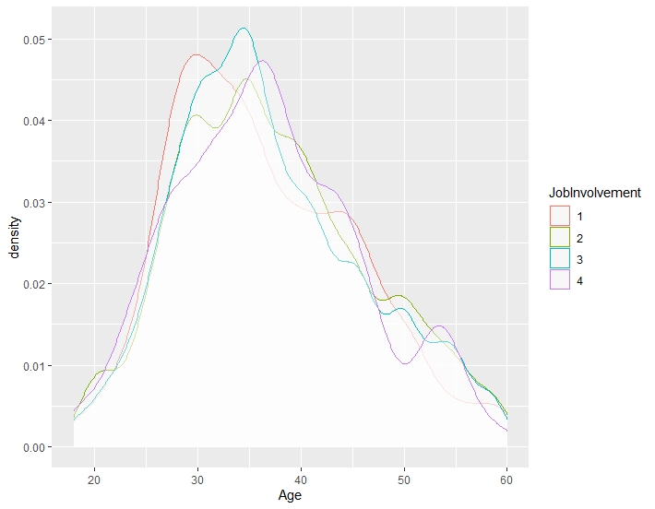
DATA EXPLORATION (LINK)
Analysis of Age
Least involved employees tend to be the youngest
Most involved employees tend to be the oldest
Positive correlation between age and job involvement?
Harvinder Singh Chahal
Notes:
Least involved tend to be youngest, centred around 30
Most involved tend to be older, centred around 40
Senior employees (above age 50) tend to be highly or very highly involved in their jobs

Slide 37
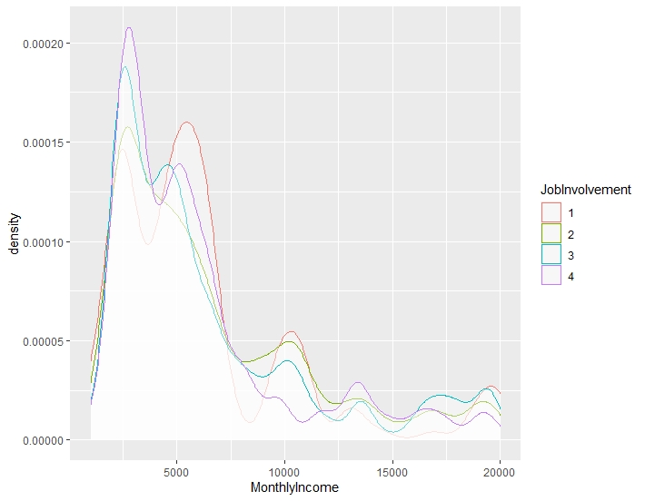
DATA EXPLORATION (LINK)
Analysis of MonthlyIncome
Least involved employees tend to be paid the highest, centered at age $6000
Most involved employees tend to be paid the lowest, centered around $3000
Counter-intuitive?
Harvinder Singh Chahal

Slide 38
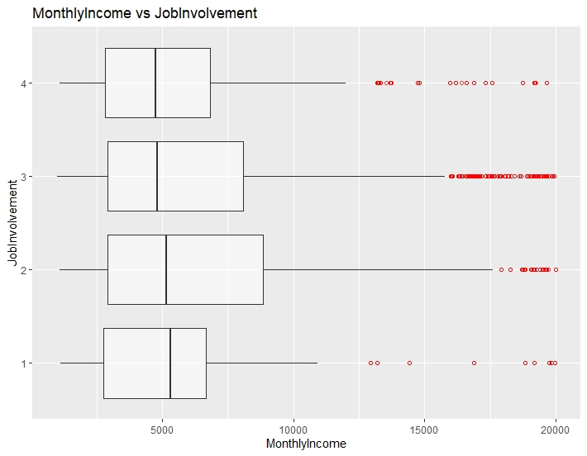
DATA EXPLORATION (LINK)
Analysis of MonthlyIncome
Least involved employees had the highest median monthly income, at $6000
Most involved employees had the lowest median monthly income, at $4000
Inequitable remuneration policy?
Harvinder Singh Chahal

Slide 39
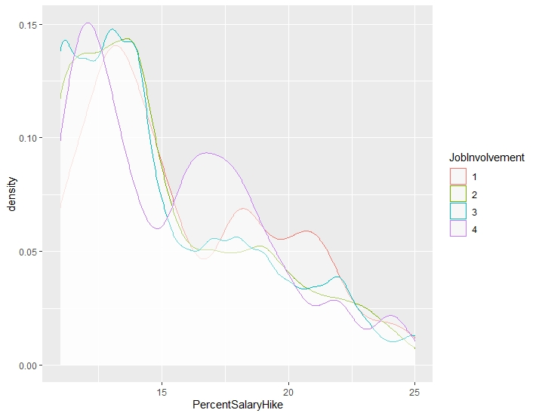
DATA EXPLORATION (LINK)
Analysis of PercentSalaryHike
Least involved employees tend to attain the highest percentage salary hike, centered around 12% and 22%
Most involved employees tend to attain the lowest percentage salary hike, centered around 6% and 17%
Counter-intuitive?
Harvinder Singh Chahal

Slide 40
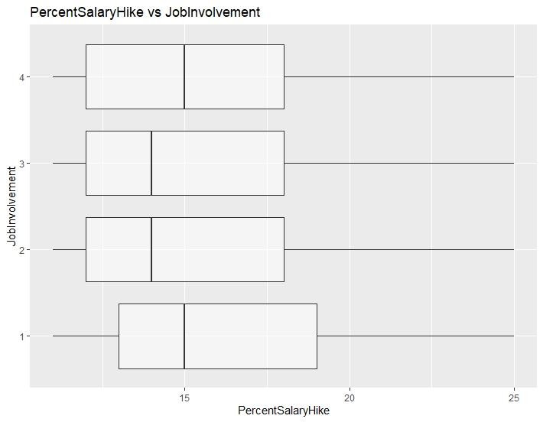
DATA EXPLORATION (LINK)
Analysis of PercentSalaryHike
Least involved employees had approximately the same median percentage salary hike as most involved employees, at 15%
Neutrally involved employees had significantly lower median percentage salary hikes, at 10%
Inequitable remuneration policy?
Harvinder Singh Chahal

Slide 41
DATA MODELLING (LINK) - CART
Phase 1
Phase 2
Testing the CART model
Growing the tree to the maximum
Pruning the tree to the optimal
Grow the tree
Overfitted tree
Identify optimal tree
Automate search for optimal tree
Prune the tree
Lum Yao Zong, Edward
Notes:
CART for categorical Y variable (JobInvolvement1) → Classification tree

Slide 42
DATA MODELLING (LINK) - CART
Phase 1 - Grow the Tree (rpart)
Determination of the best binary splits
Data = link_trainset
Method = ‘class’
Minsplit = 12 (predetermined stopping criteria)
Cp = 0
Result?
Lum Yao Zong, Edward
Notes:
CART algorithm will consider and test all x variables and their possible values to determine the best binary splits, which eventually results in the generation of the most possible purest child node, on average. The process continues until a predetermined stopping criteria is met (terminal nodes are 100% pure, number of observations in each terminal node hits the pre-specified minimum.
Minsplit = 12 → minimum 12 observations in each node before a split can occur
CP = 0 → to allow the tree to grow to the maximum
The result will be an overfitted tree → model to be complex and difficult to interpret → poor test set performance.

Slide 43
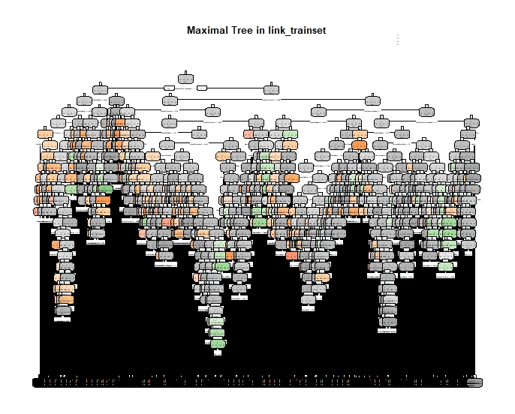
DATA MODELLING (LINK) - CART
Phase 1 - Overfitted tree
Lum Yao Zong, Edward

Slide 44
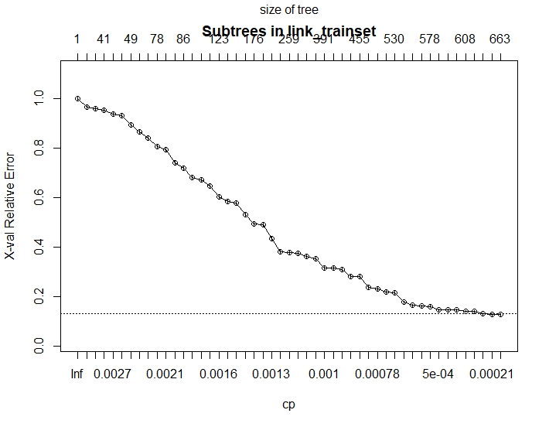
DATA MODELLING (LINK) - CART
Phase 2 - Identify Optimal Tree (plotcp)
Identify optimal tree
Simplest tree with the highest CV error right within the CV error cap
Unclear to identify based on observation
Lum Yao Zong, Edward
Notes:
Plotcp = plot CV errors with its corresponding prune triggers (CP)
To observe the optimal tree → unclear

Slide 45
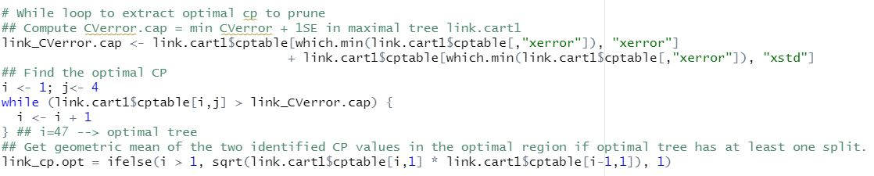
DATA MODELLING (LINK) - CART
Phase 2 - Automate the Search for Optimal Tree (while loop)
Compute CV error cap = min CV error + 1 SE
Find the optimal CP using while loop
Compute geometric mean of optimal CP and (CP-1) values
Lum Yao Zong, Edward
Notes:
I = 47 → 47th prune sequence will give us the optimal tree

Slide 46
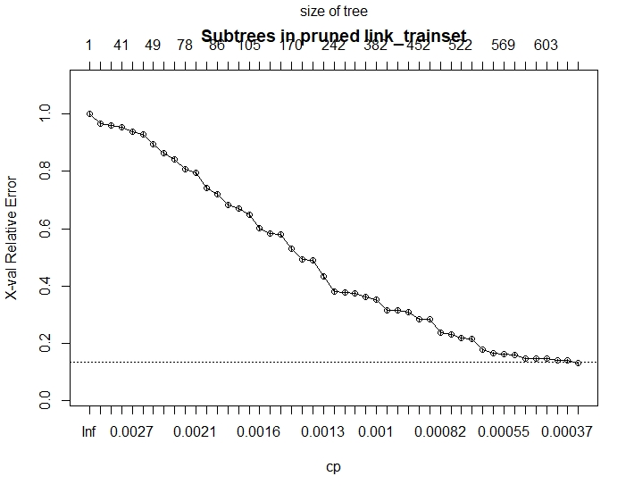
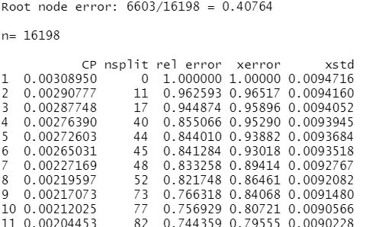
DATA MODELLING (LINK) - CART
Phase 2 - Prune the Tree (prune)
Only 1 CV error that is right below the CV error cap
Root node error = 0.40764
Remaining splits = 633
Lum Yao Zong, Edward
Notes:
Plotcp and Printcp

Slide 47
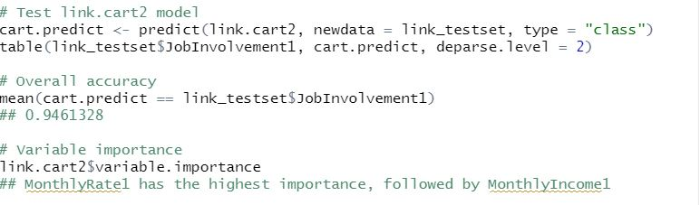
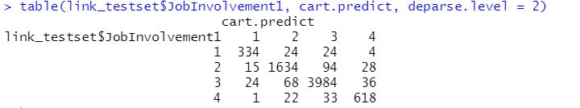
DATA MODELLING (LINK) - CART
Testing the CART Model
Data = link_testset
Overall accuracy = 94.6%
MonthlyRateNew is the most important variable
Lum Yao Zong, Edward

Slide 48
Sacrifice
Lum Yao Zong, Edward

Slide 49
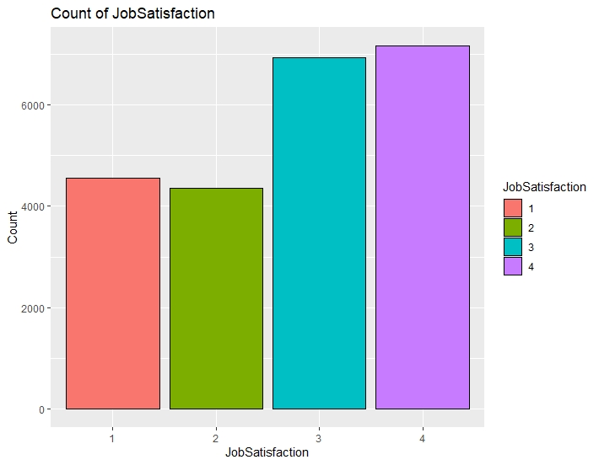
DATA EXPLORATION (SACRIFICE)
Analysis of JobSatisfaction
Majority of employees have high and very high job satisfaction levels
Generally very satisfied with their jobs and company
Suggests a high level of sacrifice should employees decide to leave
Lum Yao Zong, Edward

Slide 50
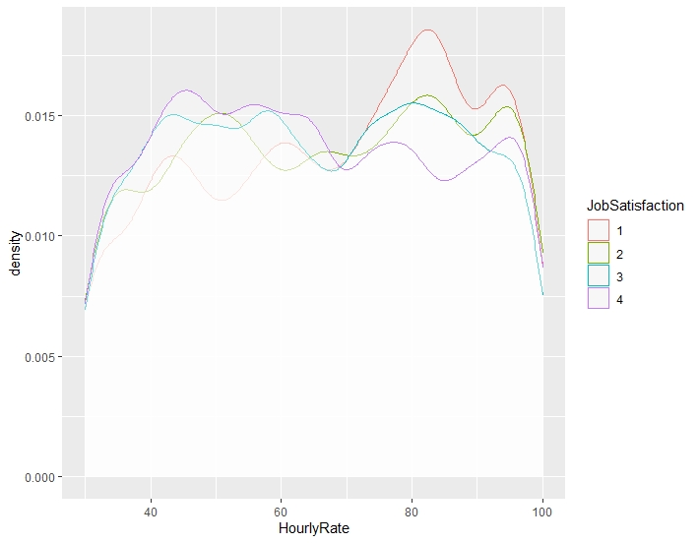
DATA EXPLORATION (SACRIFICE)
Analysis of HourlyRate
Least satisfied employees tend to be paid the highest, at around $83 per hour
Most satisfied employees tend to be paid the lowest, at around $45 per hour
Peak observed around upper hourly rate bracket for least satisfied employees
Negative correlation between hourly rate and job satisfaction?
Lum Yao Zong, Edward
Notes:
Employees (senior management) who are receiving relatively higher remuneration are however the less satisfied with their jobs compared to employees who are paid lower.

Slide 51
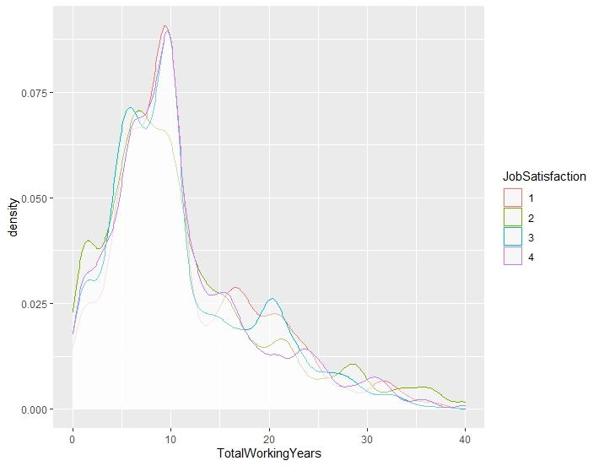
DATA EXPLORATION (SACRIFICE)
Analysis of TotalWorkingYears
Similar distribution of total working years across all categories of job satisfaction
Majority of employees have worked for around 10 years in total
Right skewness suggests that employees are mostly of a younger demographic
More informative should the company has more senior employees
Lum Yao Zong, Edward
Notes:
Current demographic: around age 20 to 35? (total working years = 10)
Ideal demographic: include more senior employees (>age 35) ( total working years > 10) → exemplified by the more different distribution for employees having worked >10 years in total

Slide 52
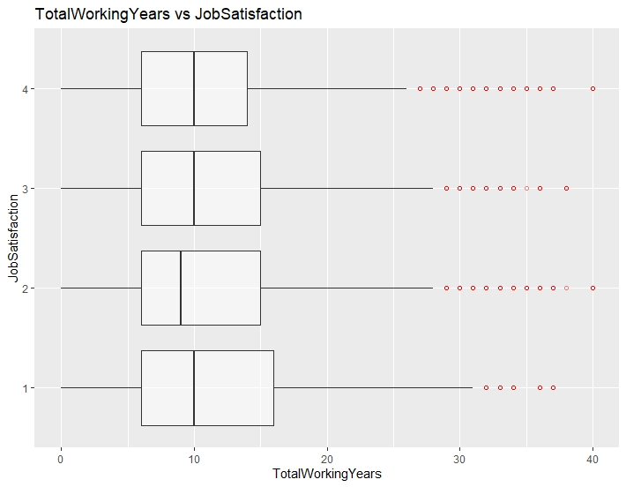
DATA EXPLORATION (SACRIFICE)
Analysis of TotalWorkingYears
Similar distribution of total working years across all categories of job satisfaction
Similar interquartile ranges, between 6 to 15 working years in total
Lum Yao Zong, Edward

Slide 53
DATA MODELLING (SACRIFICE) - CART
Phase 1
Phase 2
Testing the CART model
Growing the tree to the maximum
Pruning the tree to the optimal
Grow the tree
Overfitted tree
Identify optimal tree
Automate search for optimal tree
Prune the tree
Lum Yao Zong, Edward
Notes:
CART for categorical Y variable (JobInvolvement1) → Classification tree

Slide 54
DATA MODELLING (SACRIFICE) - CART
Phase 1 - Grow the Tree (rpart)
Determination of the best binary splits
Data = sac_trainset
Method = ‘class’
Minsplit = 12 (predetermined stopping criteria)
Cp = 0
Result?
Lum Yao Zong, Edward
Notes:
CART algorithm will consider and test all x variables and their possible values to determine the best binary splits, which eventually results in the generation of the most possible purest child node, on average. The process continues until a predetermined stopping criteria is met (terminal nodes are 100% pure, number of observations in each terminal node hits the pre-specified minimum.
Minsplit = 12 → minimum 12 observations in each node before a split can occur
CP = 0 → to allow the tree to grow to the maximum
The result will be an overfitted tree → model to be complex and difficult to interpret → poor test set performance.

Slide 55
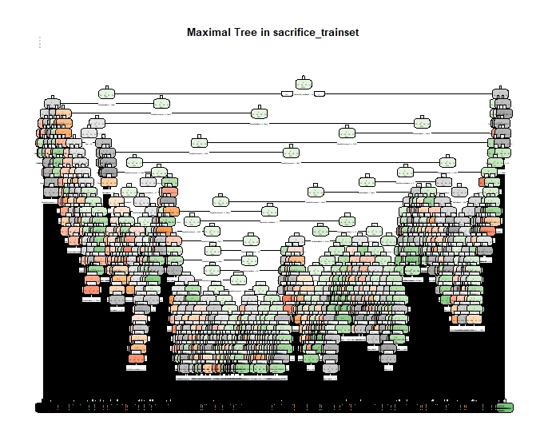
DATA MODELLING (SACRIFICE) - CART
Phase 1 - Overfitted tree
Lum Yao Zong, Edward

Slide 56
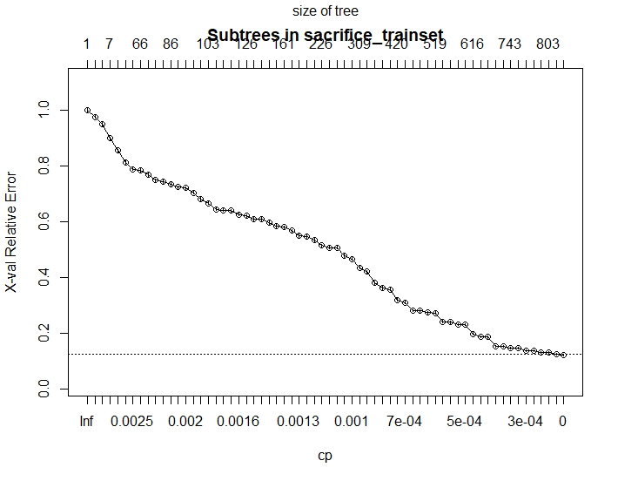
DATA MODELLING (SACRIFICE) - CART
Phase 2 - Identify Optimal Tree (plotcp)
Identify optimal tree
Simplest tree with the highest CV error right within the CV error cap
Unclear to identify based on observation
Lum Yao Zong, Edward
Notes:
Plotcp = plot CV errors with its corresponding prune triggers (CP)
To observe the optimal tree → unclear

Slide 57
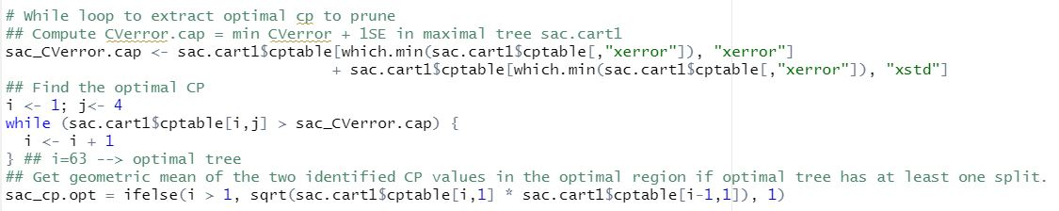
DATA MODELLING (SACRIFICE) - CART
Phase 2 - Automate the Search for Optimal Tree (while loop)
Compute CV error cap = min CV error + 1 SE
Find the optimal CP using while loop
Compute geometric mean of optimal CP and (CP-1) values
Lum Yao Zong, Edward
Notes:
I = 63 →63rd prune sequence will give us the optimal tree

Slide 58

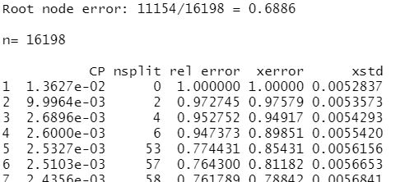
DATA MODELLING (SACRIFICE) - CART
Phase 2 - Prune the Tree (prune)
Only 1 CV error that is right below the CV error cap
Root node error = 0.6886
Remaining splits = 824
Lum Yao Zong, Edward
Notes:
Plotcp and Printcp

Slide 59
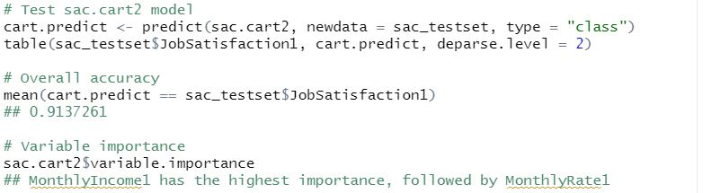
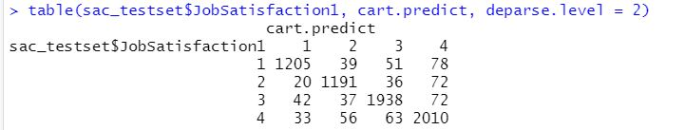
DATA MODELLING (SACRIFICE) - CART
Testing the CART Model
Data = sac_testset
Overall accuracy = 91.4%
MonthlyIncome1 is the most important variable
Lum Yao Zong, Edward

Slide 60
EMPLOYEE ATTRITION
Fung Kai Xiang Daniel

Slide 61
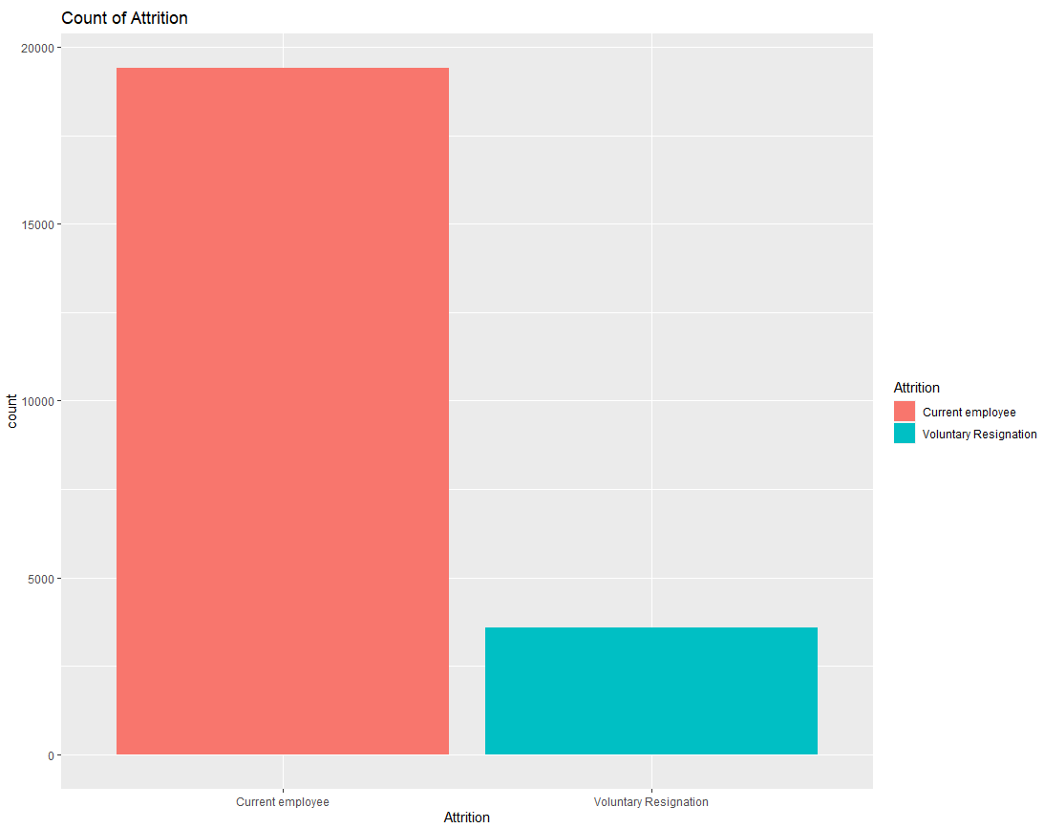
DATA EXPLORATION - ATTRITION
Analysis of Attrition
Current employee - 84.3%
Voluntary resignation - 15.7%
Relatively close to the finance industry’s average of 16.7%
Fung Kai Xiang Daniel
Notes:
We start our data exploration with a simple bar graph to visualise the proportion of employees who voluntarily resigned.
We calculated that current employee make up 84.3% of the dataset, while voluntary resignation made up the remaining 15.7%
This is relatively close to the industry average of 16.7%.
As mentioned earlier, reducing voluntary resignations would mitigate the costs associated with rehiring.

Slide 62

DATA EXPLORATION - ATTRITION
Analysis of YearsAtCompany
Peak at 0 - 5 year range for those who chose to leave the company
Possible job-hopping
Fung Kai Xiang Daniel
Notes:
Then we looked at how the years at company was correlated with the attrition.
Of those who voluntarily resigned, their length of stay tended to be very short. Most spent less than 5 years at the company. There seems to be a correlation here.
This could be showing the results of job hopping, a phenomenon where job seekers are staying 3 years or less to explore more opportunities and gain progression. This could be something that our model can help you with as well.

Slide 63

DATA EXPLORATION - ATTRITION
Analysis of Median of YearsAtCompany & Job Satisfaction and Involvement
Highest median years for low involvement with low satisfaction & high satisfaction
Shows that different employees stay for different reasons
Fung Kai Xiang Daniel
Notes:
Next, let’s look at a heatmap for the median Years At Company. Each grid cell is a combination of JobSatisfaction & JobInvolvement.
We can see that the highest median years is for JobSatisfaction = 1, JobInvolvement = 1, and JobSatisfaction = 4, JobInvolvement = 1.
This seems contradictory, but it can be explained by the fact that there are reasons other than satisfaction or involvement to stay at a company such as to learn new skills (Accenture, 2011).
This confirms our goal to tailor retention strategies to the individual.

Slide 64
DATA MODELLING - ATTRITION
Fitting the Logistic Regression
Testing the Regression model
Fung Kai Xiang Daniel
Notes:
We fit a logistic regression for predicting attrition as attrition has only 2 levels.
The process is goes back and forth. We had to switch between fitting the model and testing the model to get a useful model.

Slide 65

DATA MODELLING - ATTRITION.log1
Fitting the model...
Odds ratio (OR)
OR Confidence Intervals
Fung Kai Xiang Daniel
Notes:
To start, we fit the logistic model with the predicted variables of each component: JobSatisfaction, JobInvolvement, and YearsAtCompany
We obtained these odds ratio and the confidence intervals.
We found that these variables did indeed influence attrition at a 95% confidence interval.

Slide 66

DATA MODELLING - ATTRITION.log1
P-value
Prediction results
Overall Accuracy 84%?
Imbalanced prediction → Try to balance!
Fung Kai Xiang Daniel
Notes:
We calculated the p-value to judge each variable’s significance. As they are all very low, all variables are considered significant.
The prediction results we obtained are unexpected because our first logistic model did not predict any cases of voluntary resignation. On the surface, the accuracy of 84% seems good, but it is meaningless because the model does not help to predict employees who plan to resign.
If we take resignation as the positive case we are trying to detect, true positive rate is 0!
This is a common problem with imbalanced datasets.
The solution was to balance the data before fitting the model.

Slide 67

DATA MODELLING - ATTRITION.log2
Fitting the model...
Odds ratio (OR)
OR Confidence Intervals
Fung Kai Xiang Daniel
Notes:
We fit another logistic model, this time with a balanced dataset. We used the SMOTE function to resample the dataset such the proportions of “current employee” and “voluntary resignation” are more balanced. This allows the model to learn more from the the previously underrepresented cases.
Again, we obtained odds ratio and confidence intervals. The 95% confidence intervals again show that these variables are significant in influencing attrition.

Slide 68

DATA MODELLING - ATTRITION.log2
P-value
Prediction results
Overall Accuracy is lower - 51%
True positive rate is better - 18%
Fung Kai Xiang Daniel
Notes:
Again, the p-values indicate that the variables are statistically significant.
Our new results are better.
Although overall accuracy of the model is lower at 51%, the true positive rate is better at 18%. This means that out of the 3607 employees flagged to resign, 652 actually resigned. This gives us the chance to intervene and retain these employees. We only miss 435 who actually resigned.
We are able to predict 60% of those intending to resign before they actually resign.

Slide 69
OUR CONCLUSION
04
Fung Kai Xiang Daniel
Notes:
To sum up, here is how to use our models

Slide 70

RECOMMENDATION
Gather Data
Apply Model
Questionnaire
Find high flight risk employees
Job Embeddedness Theory
Predict Attrition
Analyse Results
Retain by focusing on root cause
Perform actions case-by-case
Take Action
Fung Kai Xiang Daniel
Notes:
Firstly, if your company lacks any input data, we have designed a questionnaire that helps to gather the needed information to run our analysis. This automates the data entry process and removes the guesswork from employee check-up interviews.
Then, we run the models using the data collected and try to predict employees who intend to voluntarily resign.
For these predicted employees, we can analyse each component of the job embeddedness framework and try to determine what changes can be made to encourage them to stay. For instance, more training opportunities can be given to employees who show low JobSatisfaction.

Slide 71
THANK
YOU!

Slide 72
Any
Questions?

Slide 73
LIMITATIONS
White Rock has only one data scientist
Physically taxing for him
Train HR employees to perform the basic process
2. Model may be ineffective in cases where anomalies exist
Only take into account variables based on Job Embeddedness Theory
Did not account for external factors e.g family situation
Prediction may not be an accurate representation of an employee’s actual flight risk
3. Our model have been trained by a hypothetical dataset provided by IBM
Insights may be influenced by American workplace culture and social norms
White Rock has to retrain our models on their dataset
Fung Kai Xiang Daniel

